Slide 1


Alexander Rafael
29th March 2025

Slide 2

Outline
Executive Summary
Introduction
Methodology
Results
Conclusion
Appendix

Slide 3
Executive Summary
This project aims to predict whether a rocket launching is success or failed to help the business understanding and requirements of SpaceX Coorporation based on the historical records of SpaceX Rocket Launches. In order to predict it, there are several details that needs attention.
Methodology
The historical data will be collected by using SpaceX API and scrap the records from the Wikipedia. To ensure its quality, the data will being wrangled with some manipulation and exploration. There are several visualization that ease to understand the pattern of data’s distribution. Finally, there are 4 classification models : logistic regression, K nearest neighbours, support vector machine and decision tree that will be fitted and evaluated to get the best accuracy score.
Results
Based on the fitted model, there are 3 models that has the same accuracy’s score : Logistic Regression, Support Vector Machine and Decision Tree with 100% Accuracy. Because the small size of dataset, it may lead to a limitation on this project which doesn’t rule out the possibility that the models is not generalized since less data that can be used for training the model.

Slide 4
Introduction
Background
SpaceX has the Falcon 9 Rocket Launches that can reuse its first stage for another launching if the launch was successful.
Therefore, SpaceX may reduce the cost of a launch to 62 Million Dollars, rather than the other providers upward of 165 million dollars
Problems
To have an effective advertisement of the cheaper launch cost, SpaceX needs to predict the launches outcome.
The prediction will be used when another alternate company wants to bid agains SpaceX to a rocket launch.
So, to predict the outcome, we will use the Machine Learning approach using the historical launches data.

Slide 5

Section 1

Slide 6
Methodology
Executive Summary
1. Data collection methodology
The data was collected by extracting the SpaceX API and scrapping Falcon 9 and Falcon Heavy Launches on Wikipedia Website
2. Perform data wrangling
The data was processed by exploring the null values, the cardinaility of each category, and develop a new numerical target label
3. Perform exploratory data analysis (EDA) using visualization and SQL
4. Perform interactive visual analytics using Folium and Plotly Dash
5. Perform predictive analysis using classification models
Build several models, logistic regression, Support Vector Machine, Decision Tree, and K Nearest Neighbours, doing the hyperparameter tuning, fitting the data, and evaluate the results

Slide 7
Data Collection
The dataset collected by 2 methods from 2 different sources, which are:
Application program Interface (API)
A SpaceX API that connect the program with the data of SpaceX Rocket Launching Records and Histories
Web based
A wikipedia site of Falcon 9 and Falcon Heavy Launches records that includes many informations and categories about the launching records. The data will be scrapped from the webpage using a beautiful soup object

Slide 8
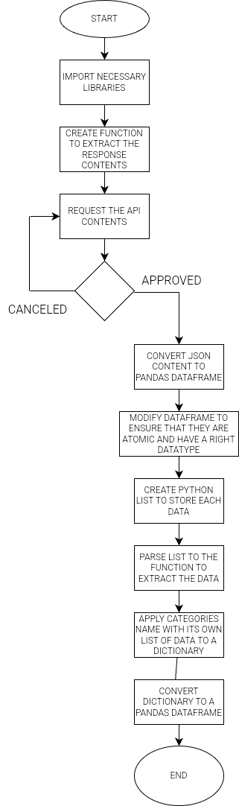
Data Collection – SpaceX API
The historical data was collected by extracting the records from the SpaceX’s Application Programming Interface that connected with the python programming languages

Slide 9
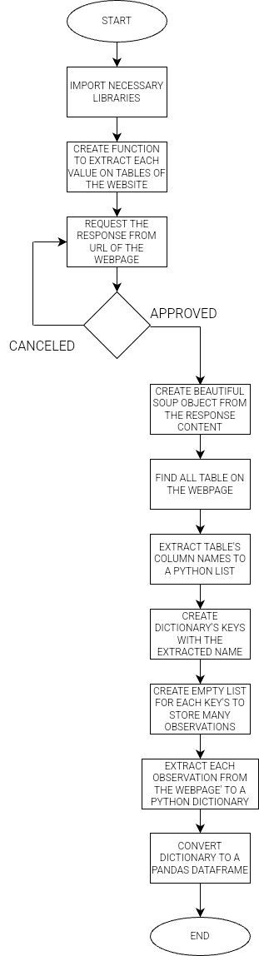
Data Collection - Scraping
The historical data was collected by scrapping the wikipedia’s site tables that relates to the Falcon 9 and Heavy Falcon Launches Records

Slide 10
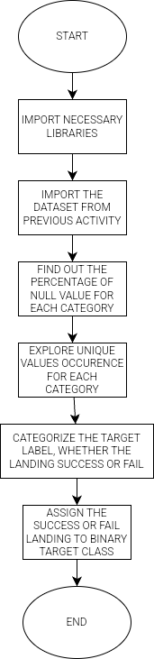
Data Wrangling
There are several actions to wrangling the data :
NULL Values, the empty record on the observation. Knowing the number of NULL Values can ease the interpretation
Cardinality, which is the number of unique values in a category, to help find inconsistent data
Labelling, which is aggregating many label into a binary target label to ease the classification from small data

Slide 11
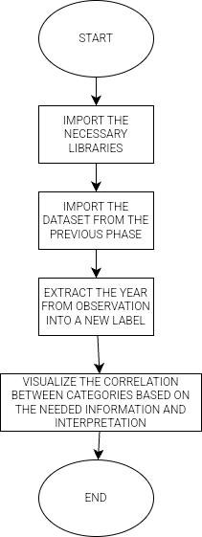
EDA with Data Visualization
There are several kinds of graphs that used in this activity, such as :
Scatter plot, aims to visualize the correlation/pattern between 2 numerical variables
Bar plot, aims to visualize the number on each categorical values, a numerical and categorical’s data distribution
Line chart, same as bar plot, to visualize a numerical and categorical, but this is to more highlight about a progress in a certain period

Slide 12
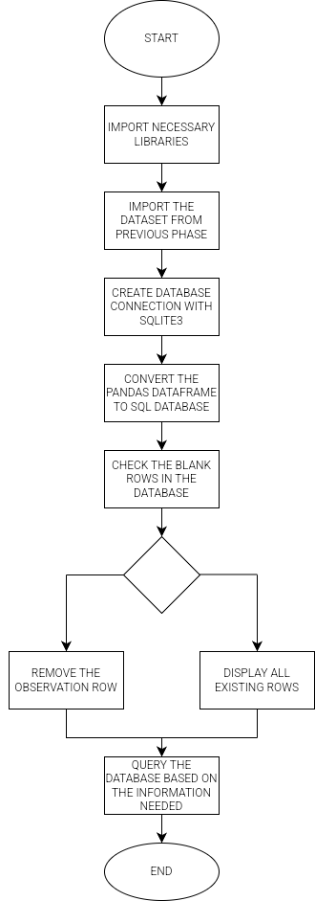
EDA with SQL
The Exploratory Data Analysis with SQL means to query data with some condition, aims to :
Knows deeper about the distribution of data in certain situation
Find out the statistical calculation and information on some categories
Perform a Data Manipulation Language with the SQL Statement

Slide 13
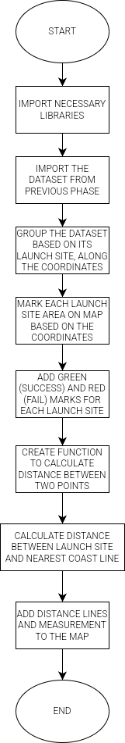
Build an Interactive Map with Folium
There will be several object that occurs in the map, such as :
Circle, indicates an area of the launch site of the launching rockets
Green mark, indicates the successful landing of the rocket
Red mark, indicates the failed landing of the rocket
Line, indicates the distance between a launch site area to another object

Slide 14
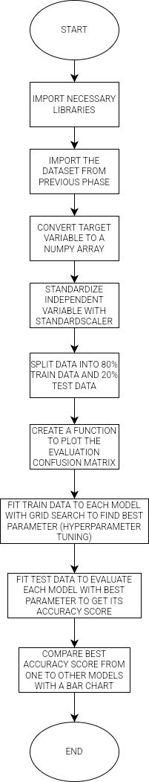
Predictive Analysis (Classification)
Because the target label either success or fail (binary), then it is categorized as classification. There are 4 common models that used for it, such as :
Logistic Regression
Support Vector Machine
K Nearest Neighbours
Decision Tree
This analysis aims to determine which model give it highest accuration to the validation data

Slide 15

Section 2

Slide 16
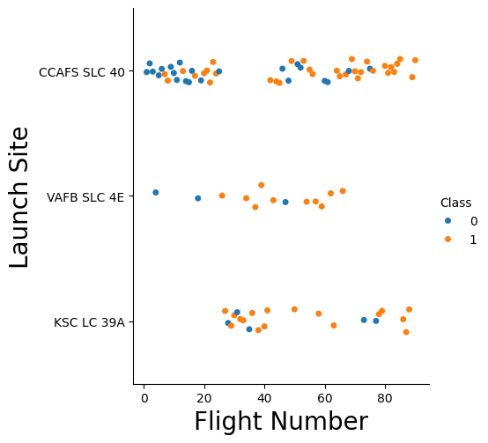
Flight Number vs. Launch Site
On CCAFS SLC 40 site has more numbers of flight, where the rest are lesser than it. Overall, there are more numbers of successful flight than the failed one.

Slide 17
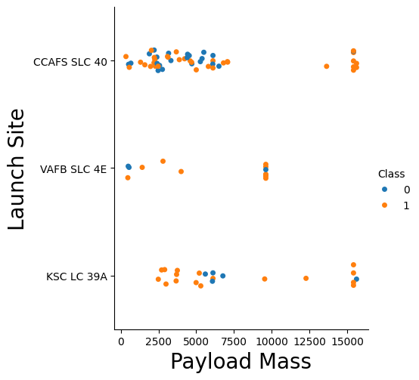
Payload vs. Launch Site
On CCAFS SLC 40 site, the launching rockets are most likely come from the light to medium mass, while for the others, there are most likely have same distribution from the level of payload mass.
The number of failed launch mostly comes from the low payload mass.

Slide 18
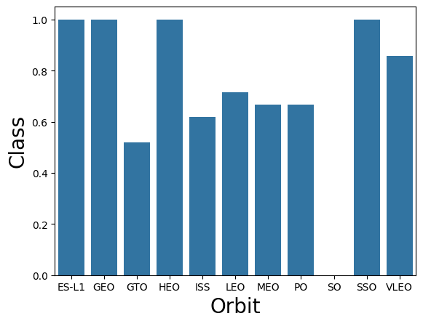
Success Rate vs. Orbit Type
Show a bar chart for the success rate of each orbit type
Show the screenshot of the scatter plot with explanations
The ES-L1, GEO, HEO and SSO orbits has the most success rate rocket launch, which is 1, or 100% success.
The SO orbit has the lowest, which there are no success launch at all.
The rest are diverse at the range 1 to 0 success rate.

Slide 19
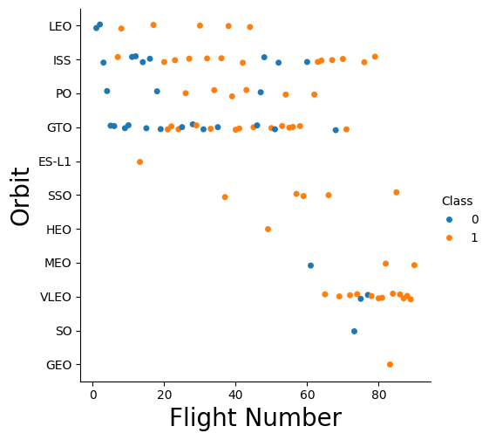
Flight Number vs. Orbit Type
Show a scatter point of Flight number vs. Orbit type
Show the screenshot of the scatter plot with explanations
The LEO, ISS, PO and GTO orbits has lots of flight number of the rocket, with its each success and fail numbers.
While the rest, only has a few of flight number.
This condition bring the analysis of data may not be relevant and accurate, because of the difference distribution of the data

Slide 20
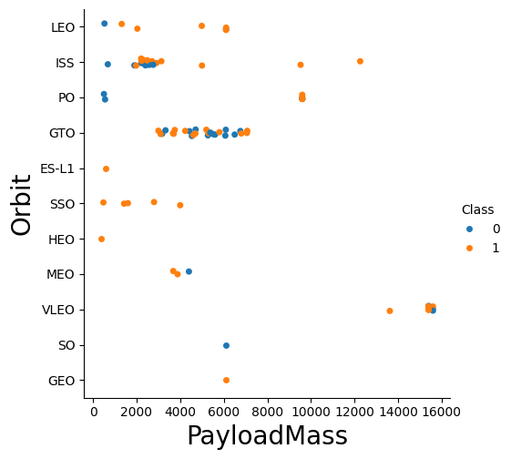
Payload vs. Orbit Type
Show a scatter point of payload vs. orbit type
Show the screenshot of the scatter plot with explanations
There are very many diverse distributions between the payload mass on each orbit, indicating that each rocket is unique each other.
In GTO orbit, the distributed rockets are most likely comes from 2000 to 8000 payload mass indicates the unique patterns and consistency there.

Slide 21
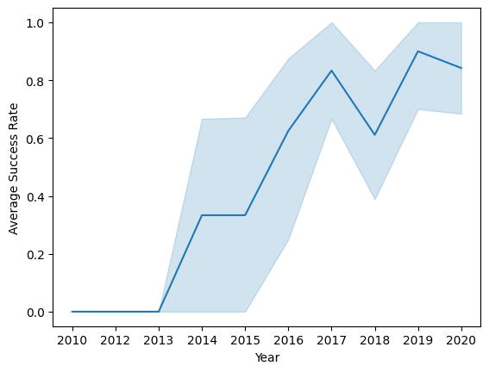
Launch Success Yearly Trend
Show a line chart of yearly average success rate
Show the screenshot of the scatter plot with explanations
From year to year,
The overall success rate of rocket launched are increases in the average, this is a good milestones that indicating the better security and performance on the systems that they are using.

Slide 22
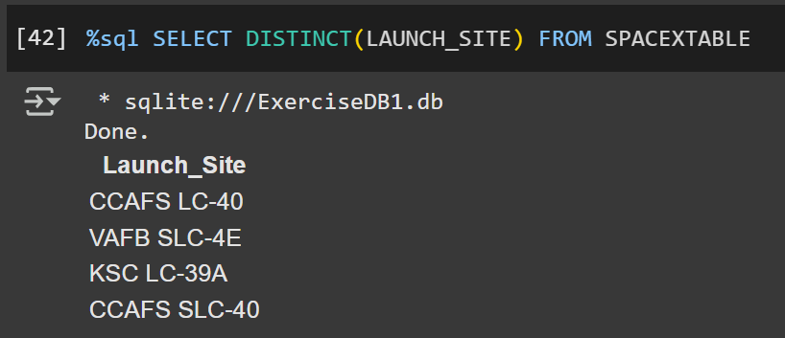
All Launch Site Names
Based on the snippet code, There are four (4) unique launch site names on the dataset as mentioned above.

Slide 23
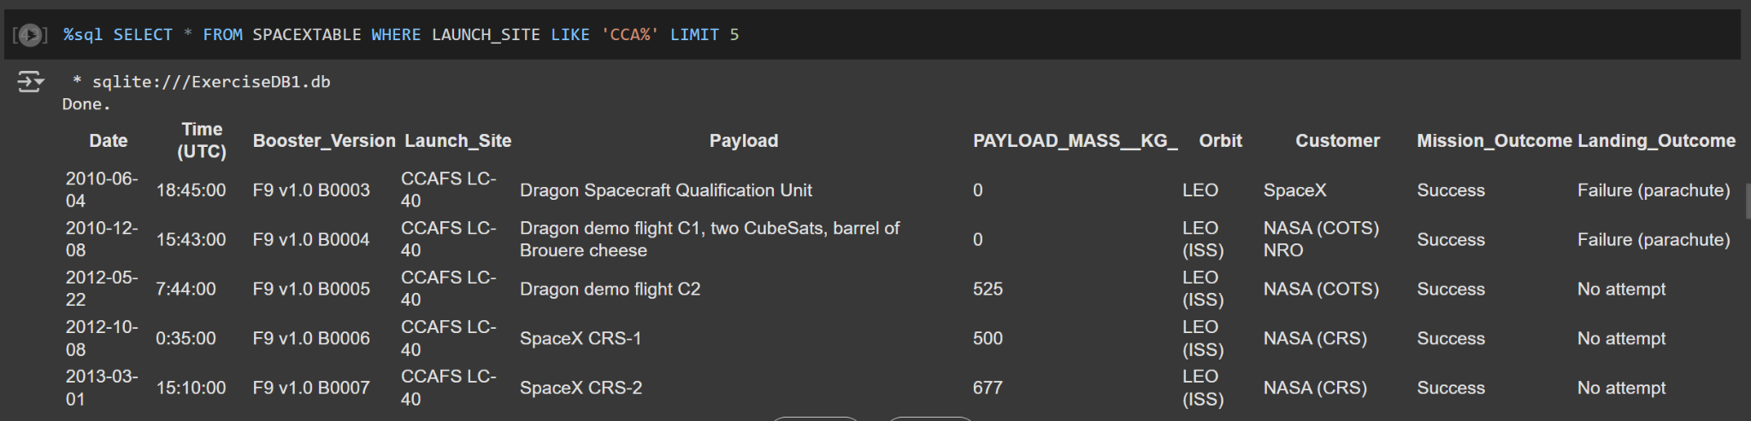
Launch Site Names Begin with 'CCA'
Based on the snippet code, There are several flight that the launch site names begin with the “CCA” characters. In this case, only the top 5 observations displayed as the limitation on the questions

Slide 24
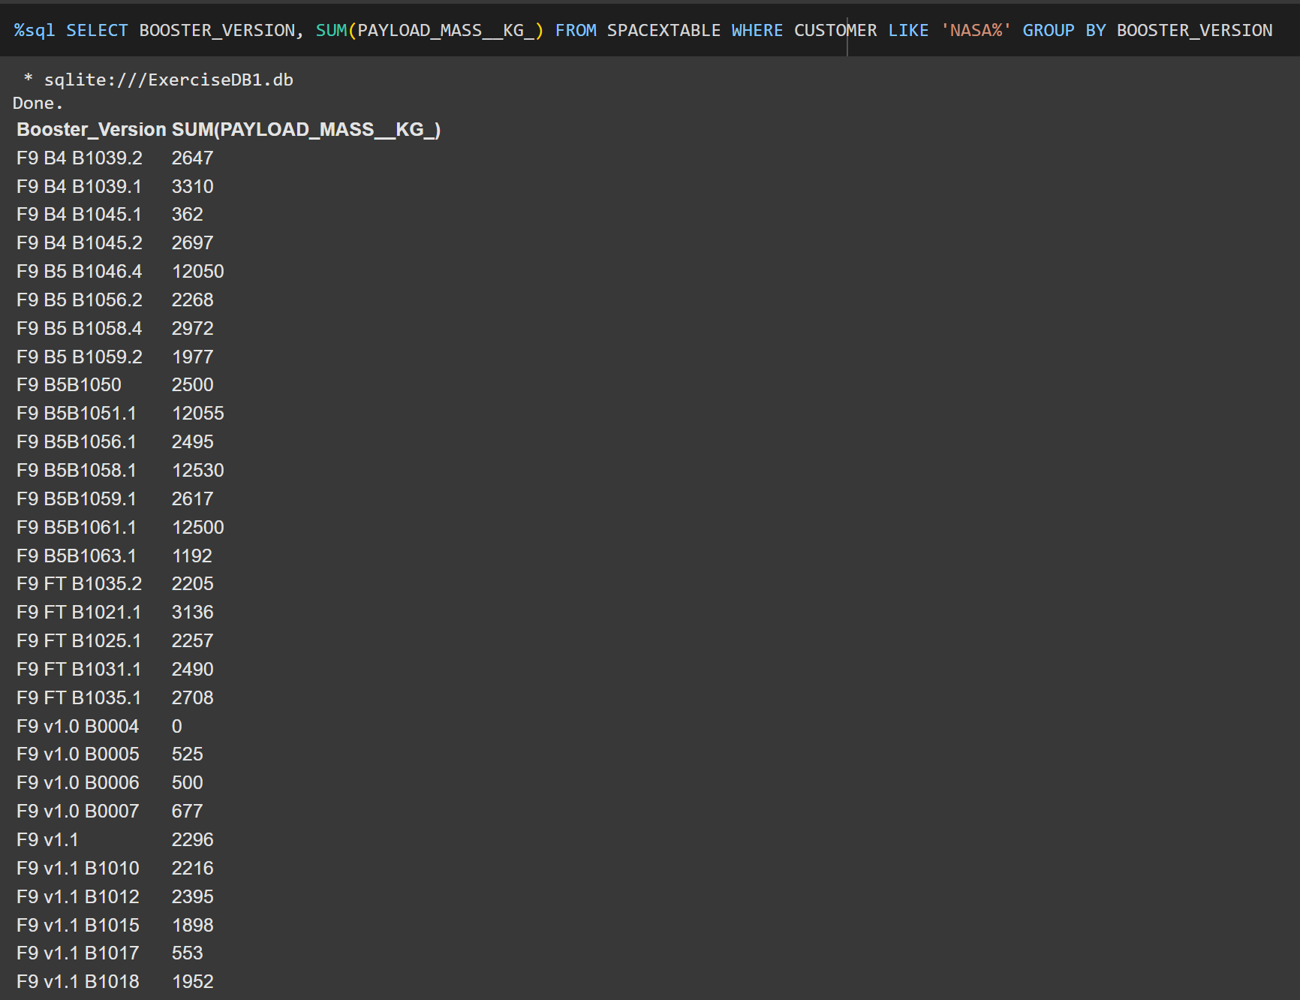
Total Payload Mass
Based on the snippet code, There are the group of the total payload mass, for each booster version type that carried by boosters from NASA.

Slide 25
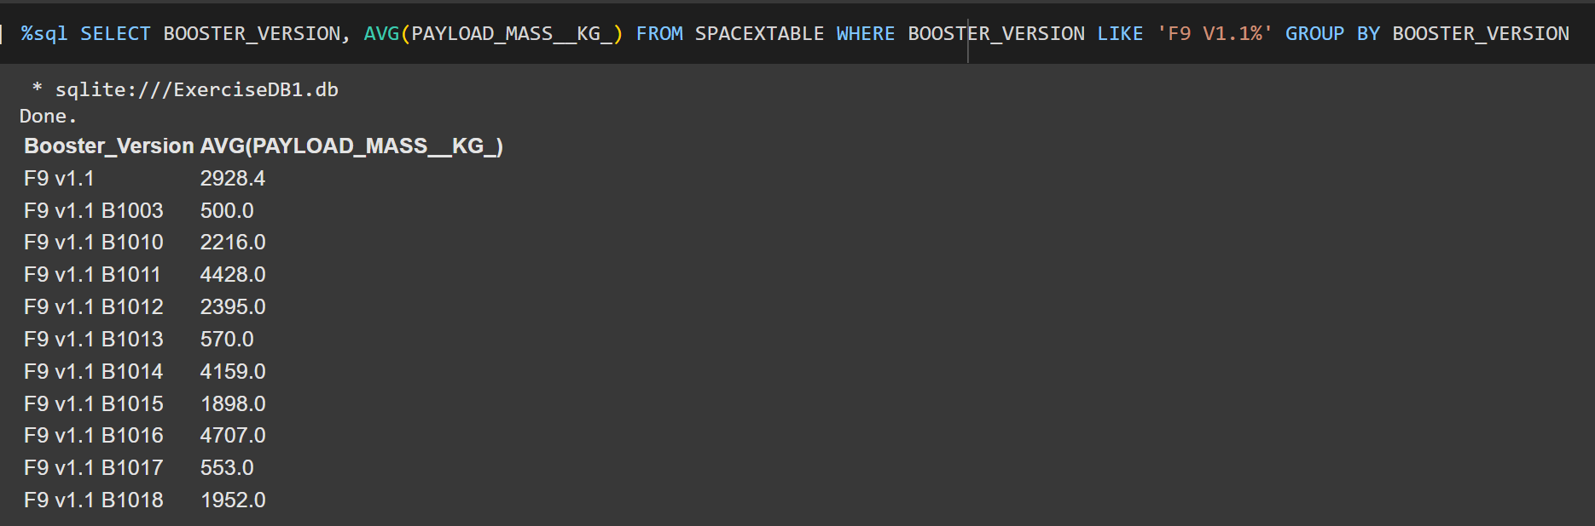
Average Payload Mass by F9 v1.1
Based on the snippet code, There are the group of payload mass average for each of the F9 V1.1 booster version type.

Slide 26
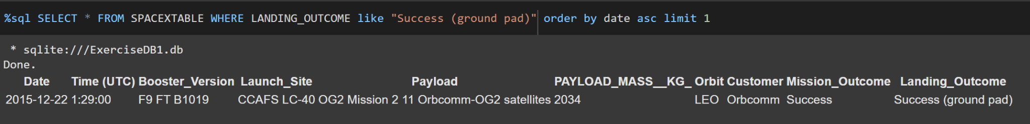
First Successful Ground Landing Date
Based on the snippet code, There is the first observation of the successful rocket launch on the ground landing.

Slide 27
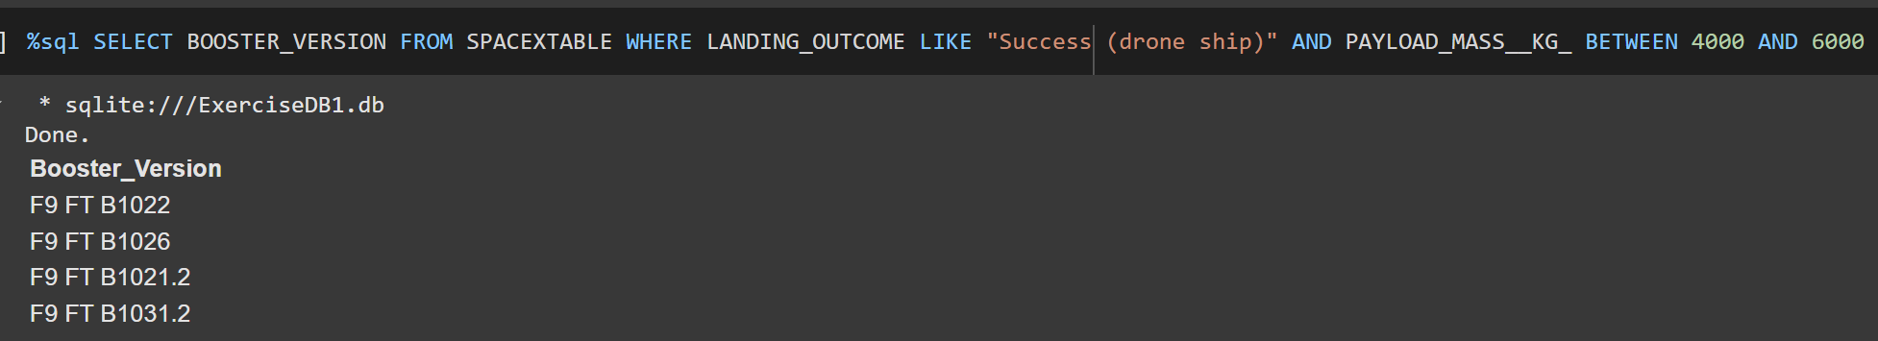
Successful Drone Ship Landing with Payload between 4000 and 6000
Based on the snippet code, there are the names of boosters which have successfully landed on drone ship and had payload mass greater than 4000 but less than 6000

Slide 28
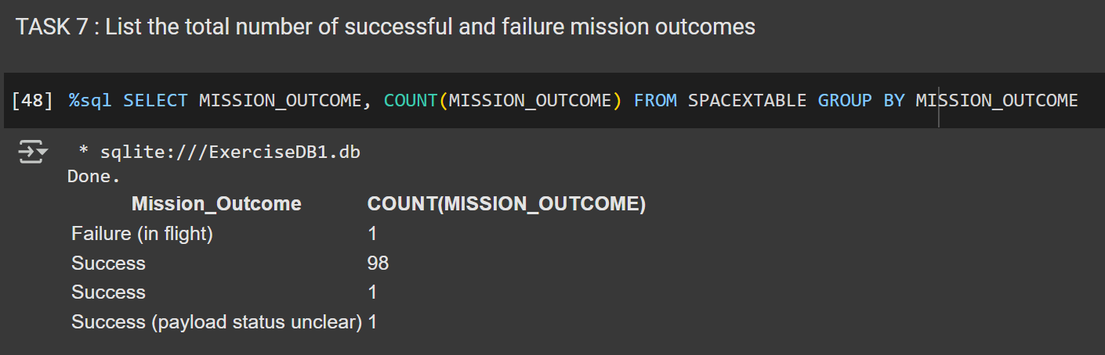
Total Number of Successful and Failure Mission Outcomes
Based on the snippet code, There are the total of calculations number of successful and failure rocket launching mission outcomes

Slide 29
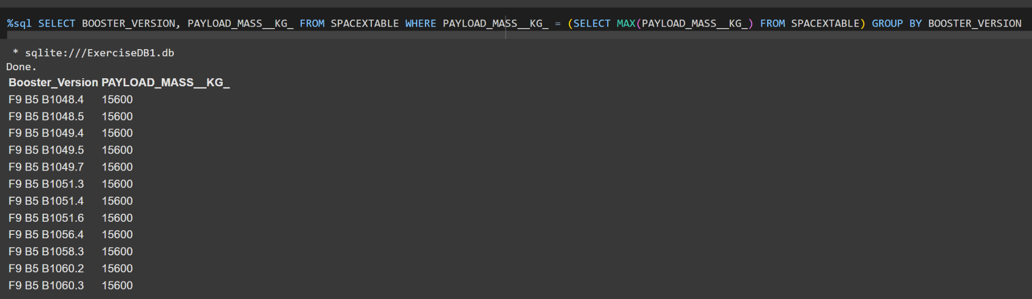
Boosters Carried Maximum Payload
Based on the snippet code, There are the group of booster’s name with its each total of payload mass for each names.

Slide 30
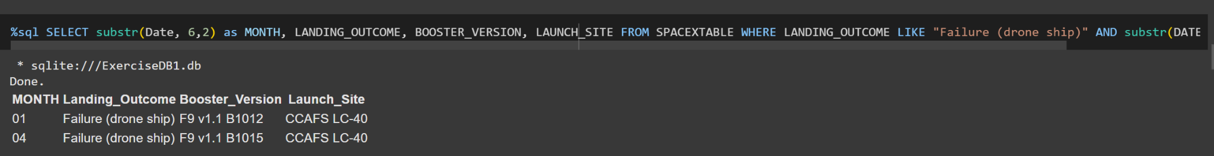
2015 Launch Records
Based on the snippet code, There are the list of observations which has failed the landing outcomes during the 2015 period.

Slide 31
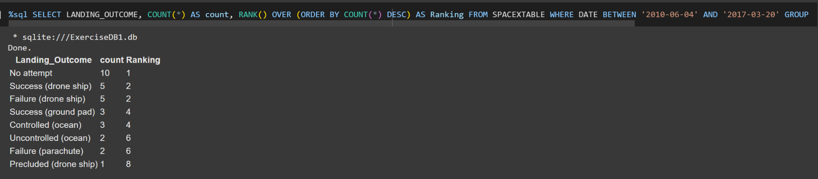
Rank Landing Outcomes Between 2010-06-04 and 2017-03-20
Based on the snippet code, there are the rank’s records of landing outcomes between the date 2010-06-04 and 2017-03-20 in a descending order

Slide 32

Section 3

Slide 33
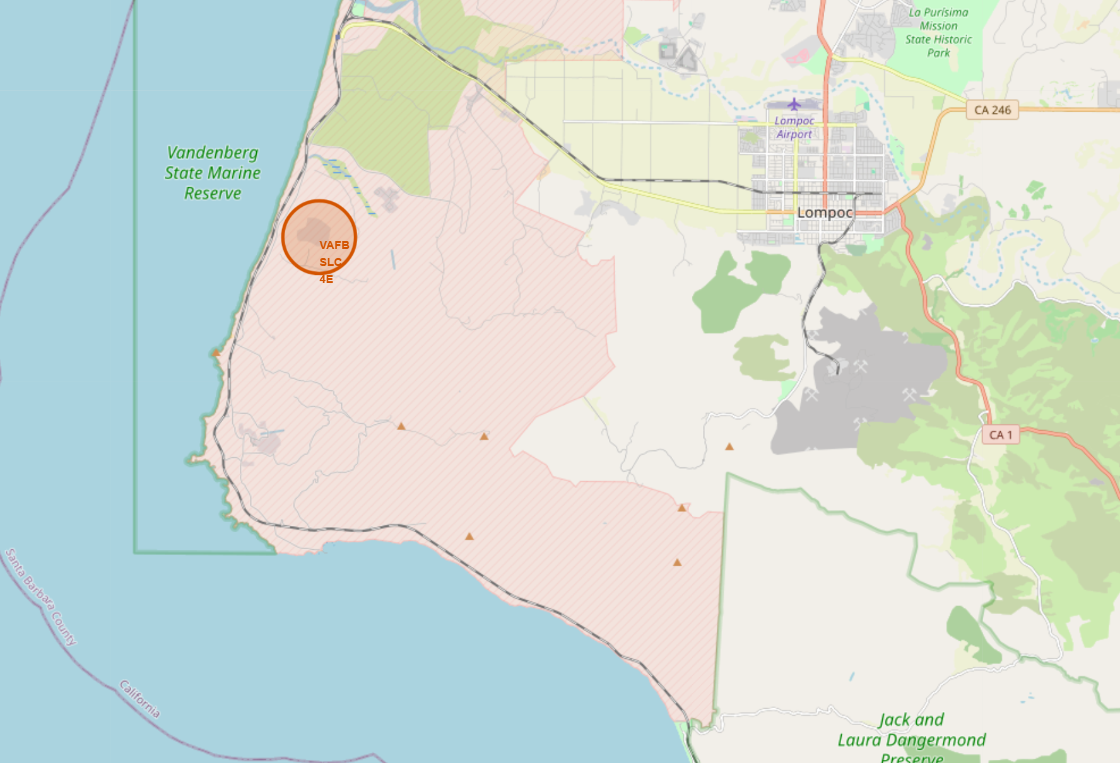
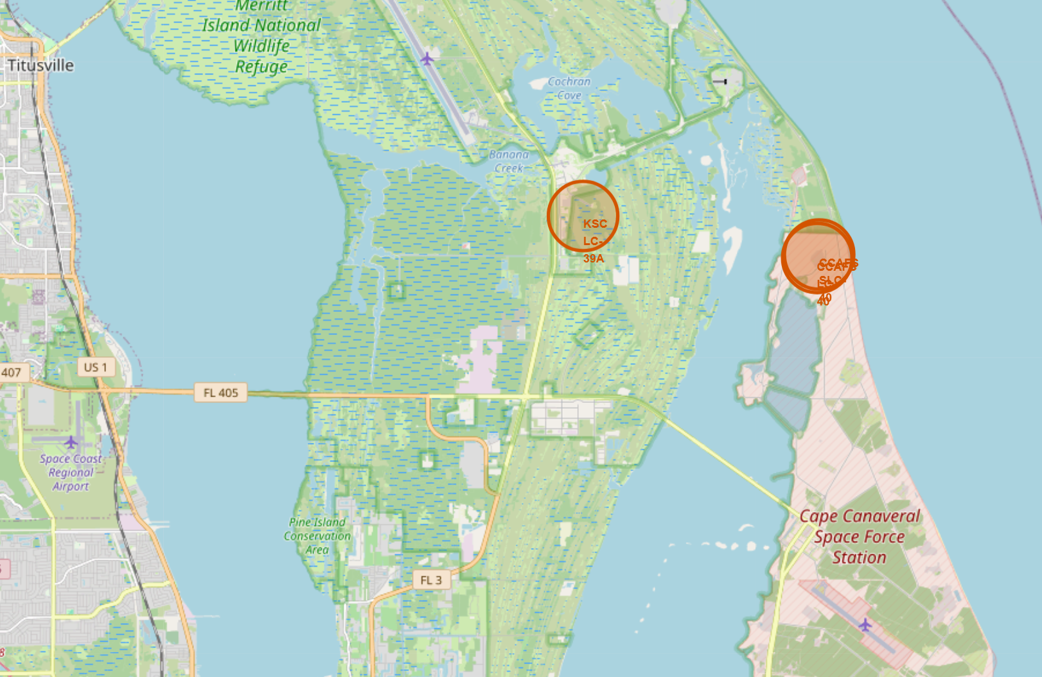
Launch Sites’ Area Distribution
Based on the map, there are the geographical places from each launch sites based on the longitude and latitude coordinates.

Slide 34
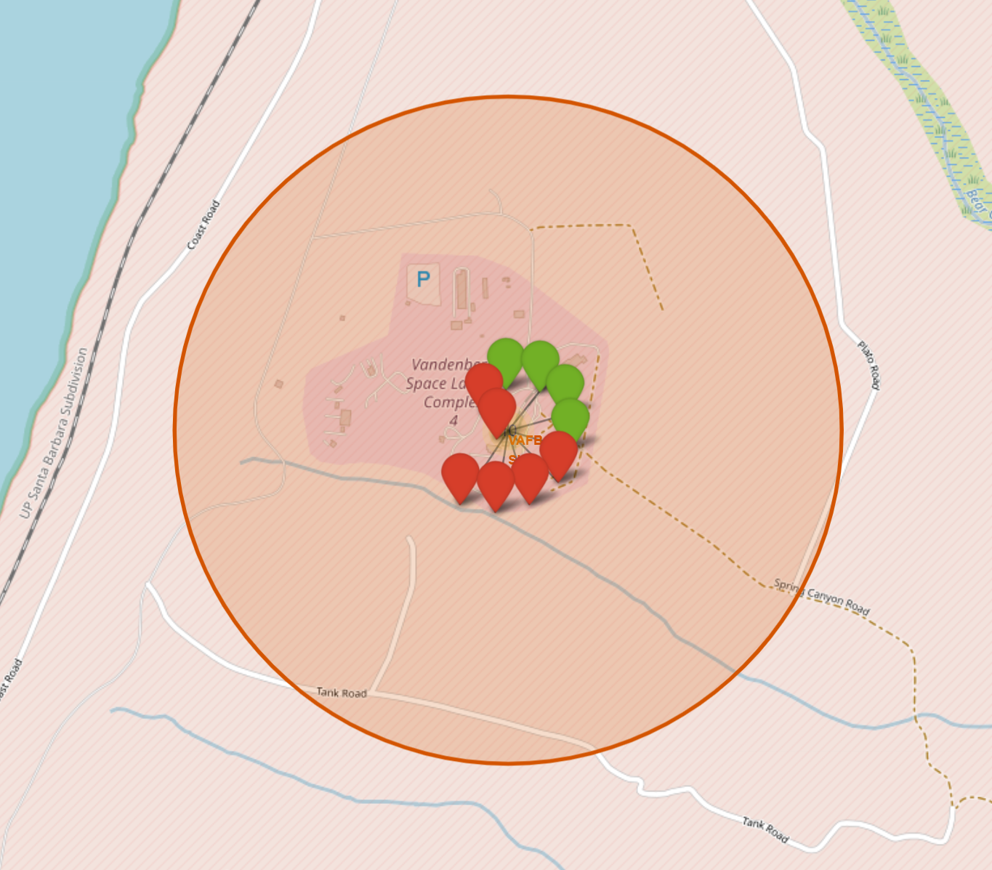
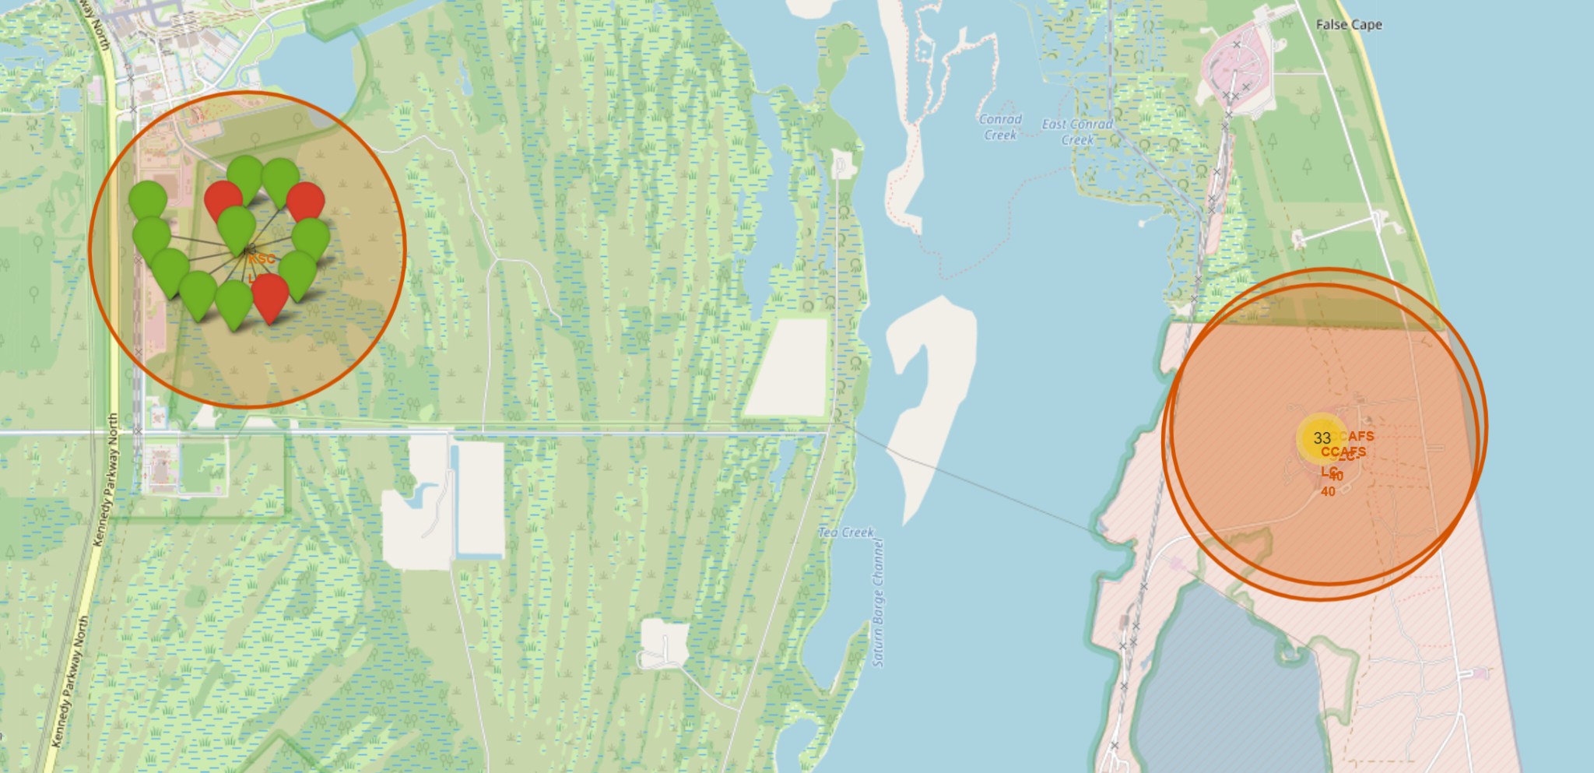
Flight’s Distribution on Each Launch Site
Based on the map, there are the detailed geographical place from each record of rocket launch on each launch site area, where the green mark indicates a successful launch, otherwise the red indicated the failed.

Slide 35
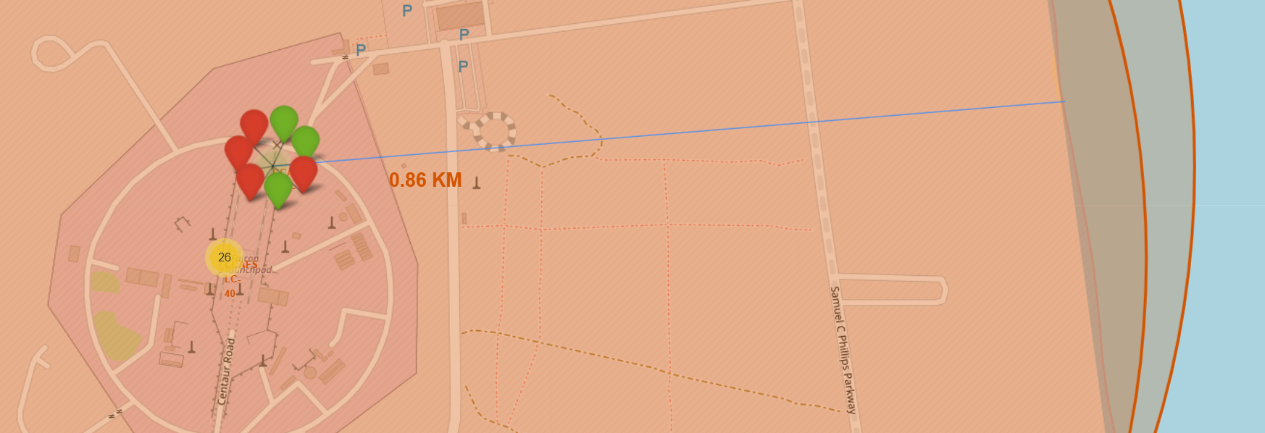
Launch Site’s Distance with Nearest CoastLine
Based on the map, there is a path of the nearest coastline from the CCAFS SLC-40 Launch Sites Area, which is 0.86 KM

Slide 36

Section 5

Slide 37
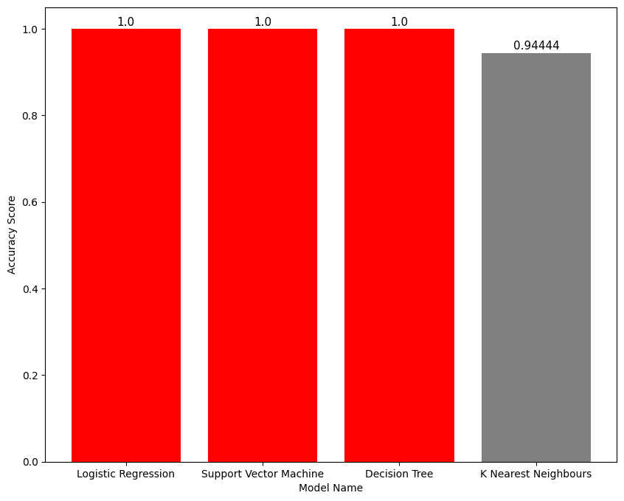
Classification Accuracy
There are 3 models at total that has the highest score of accuracy on the validation data, which consists of Logistic Regression and Support Vector Machine

Slide 38
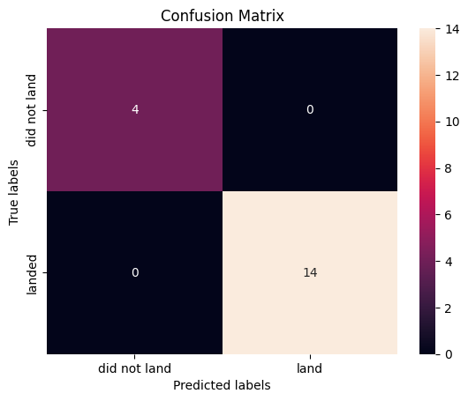
Confusion Matrix
Because the model has 100% Accuracy on testing data, its mean that all predictions all truly predicted. In matrix, we can see that there are 14 values true positive, and 4 values false negative.

Slide 39
Conclusions
The dataset has been cleaned enough that bring simplicity to the exploration, but the small size of dataset can be an obstacle for the model to learning its pattern and generalizing it.
The distribution of the data is not normal-distributed enough, because there is not equivalent count of each value on a category that may bring to less accurate results because the model doesn’t have the same number of data from each class as the learning media
Eventhough the evaluation results show a very high accuracy score, which is 100% on the 3 different models of classification, but it doesn’t rule out the possibility if there will be a miss-prediction later on, because of the limitation of provided dataset and records.

Slide 40
Appendix
Used Wikipedia’s Dataset :
https://en.wikipedia.org/wiki/List_of_Falcon_9_and_Falcon_Heavy_launches
Full Version of Python Source Code :
https://colab.research.google.com/drive/1t6AAdDuHLeohyWQdqF4tSNu5zVCdO0Fm?usp=sharing

Slide 41


